Slide 1


Compliance Audit and AI
23 November 2023
Hui Wang, Professor of AI

Slide 2
CONTENTS
1.
Traditional Compliance Audit
2.
AI Powered Compliance Audit
3.
Two Case Studies
Slide 2 | DATE: 23 Nov 2023

Slide 3


Part 1
Traditional Compliance Audit
Slide 3 | DATE : 23 Nov 2023

Slide 4
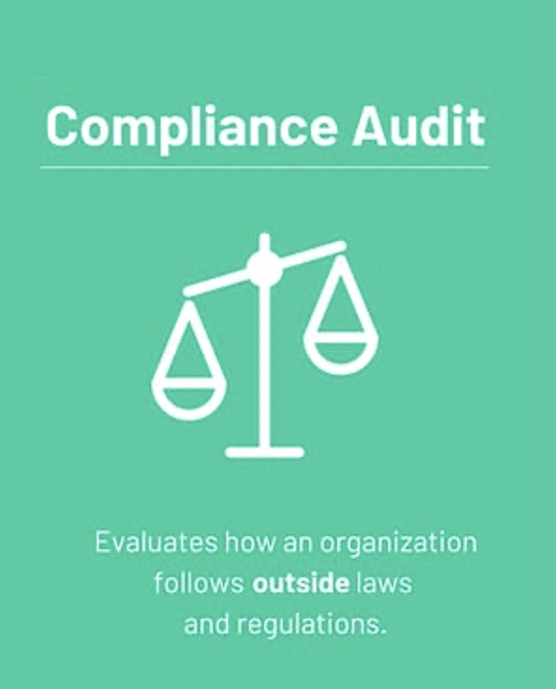
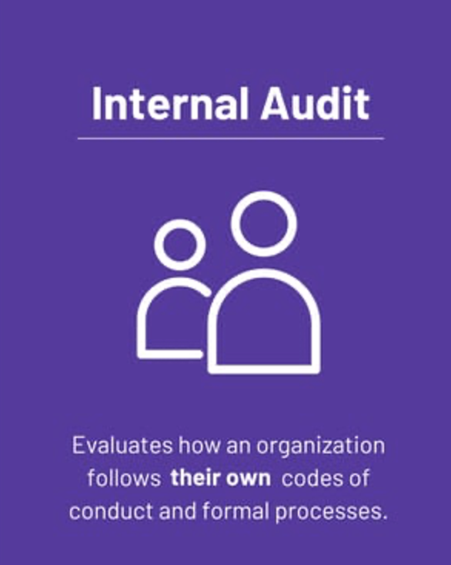
What is Compliance audit?
A systematic and independent examination of an organisation’s operations including processes and controls to determine whether they align with (1) applicable laws, regulations, industry standards, and other statutory requirements (2) internal policies and codes of conduct.
Review of an organisation’s compliance report.
Interview of key individuals re awareness of their obligations in context of all compliance requirements.
Slide 4 | DATE : 23 Nov 2023
Notes:
A compliance audit is an evaluation of whether a company is following these set standards. Compliance auditing involves the review of an organization's policies, procedures, processes, files, and documentation to determine whether they are in alignment with existing regulations in that industry.

Slide 5
Why is Compliance audit important?
Compliance requirements are indispensable to the proper functioning of systems (e.g., organisations, economies and societies)
Requirements can be e.g. legal and ethical.
They set the rules of the game, protect the rights and safety of individuals, prevent crimes, maintain system stability, and ensure the delivery of public goods and services.
Compliance audits are essential for organisations to demonstrate their commitment to compliance requirements.
Benefit organisations with Risk mitigation, Trust and reputation, Operational efficiency, Transparency and accountability, Prevention of fraud/ misconduct
Slide 5 | DATE : 23 Nov 2023

Slide 6
How to Conduct Compliance audit?
1. Decide Who Will Conduct the Audit
Individual with the necessary knowledge and skills; Be impartial and objective in their findings
2. Establish the Scope of the Audit
What risks will the audit address? What was the outcome of previous compliance audits?
3. Conduct a Risk Assessment
Identify the risks to compliance; Assess the likelihood and impact of those risks
4. Review Policies, Processes & Controls
Review polices, processes and controls to assess whether they adhere to applicable requirements
5. Analyse, Report & Suggest Corrective Actions
Detail areas of non-compliance and the root causes, and suggests corrective actions
Slide 6 | DATE : 23 Nov 2023

Slide 7
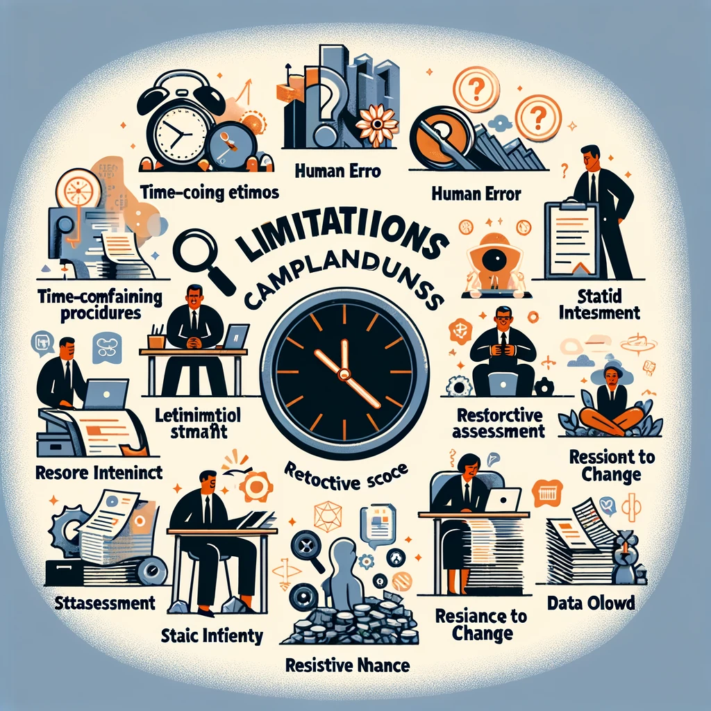
Limitations of traditional compliance audit process
Resources: This typically involves manual reviews, demanding substantial manpower and time, leading to high costs for organisations.
Auditor: Auditors may grapple with a significant volume of documentation, leading to data overload which may result in errors.
Procedure: Traditional audits often rely on sampling which results in a limited scope, and only provide a snapshot in time rather than continuous monitoring.
Slide 7 | DATE : 23 Nov 2023

Slide 8
Part 2
AI Powered Compliance Audit
Slide 8 | DATE : 23 Nov 2023

Slide 9



emerging AI technologies to enable automation
LLM as AN example
GPT-1
06/2018
GPT-2
02/2019
GPT-3
05/2020
GPT-4
03/2023
GPT-4-Turbo
11/2023
Transformer
06/2017
Bert
05/2019
T5
01/2020
Claude
03/2023
Claude2
07/2023
Roberta
07/2019
BART
10/2019
Llama
02/2023
Llama 2
07/2023
Slide 9 | DATE : 23 Nov 2023

Slide 10
changing landscape of compliance audit
On 26 April 2023, PwC announced plans to invest $1B over the next three years to expand its AI offerings and help clients reimagine their businesses through the power of generative AI.
According to THE WALL STREET JOURNAL, KPMG plans $2B investment in AI and cloud services across its business lines globally over the next five years through an expanded partnership with Microsoft.
According to a speech by KPMG Internal Audit Managing Director, generative AI is already used for compliance audit tasks such as scoping audit and doing risk assessment.
Slide 10 | DATE : 23 Nov 2023

Slide 11
in the near future…
NLP: Automated Compliance Audit
NLP can automatically review large volumes of compliance-related documents to ensure they are in line with regulatory requirements. This process reduces the time and effort required by human auditors.
CV: Financial Table Extraction in Image Docs
CV techniques such as image segmentation, Optical Character Recognition (ORC) can be utilized to identify, extract and transcribe tabular content in image documents.
NLP: Regulatory Change Management
NLP tools monitor regulatory updates and analyze the changes to help organizations understand the implications for their compliance posture and adapt their internal policies accordingly.
CV: Compliance in Advertising and Media
Computer Vision algorithms can review advertisements and other media content for compliance with regulatory standards related to misinformation, inappropriate content, and intellectual property rights.
Slide 11 | DATE : 23 Nov 2023

Slide 12
Challenges: Technological
Controllability and interpretability: The Auto-Regressive LLM cannot totally get rid of hallucination. They will still be difficult to control. Moreover, the black-box nature of LLM can still make itself hard to get implemented on high-stakes compliance audit job.
Long-range dependencies and context length: Though GPT-4 Turbo now supports a rather long context length, it may still be insufficient to handle some regulatory documents (e.g., MCOB, which has 584 pages).
Computational resource: Localizing LLM is of great interests in terms of data privacy and ease of use, however, the extremely high computation cost makes it difficult to achieve, especially for small and medium enterprises.
Slide 12 | DATE: 23 Nov 2023

Slide 13
Challenges: ethical
Privacy Concerns: Compliance audits often deal with sensitive data. AI systems capable of processing vast amounts of information may risk exposing personal data or confidential business information, intentionally or accidentally.
Job Displacement: While AI has the potential to augment auditor capabilities, it also raises concerns about the future of employment in the sector. The automation of tasks traditionally carried out by human auditors may result in job displacement.
Access and Inequality: Smaller organisations might not have the resources to implement sophisticated AI auditing tools, potentially creating to an uneven playing field where larger firms have an advantage in managing and mitigating compliance risks.
Slide 13 | DATE: 23 Nov 2023

Slide 14
Part 3
Two Case Studies
Slide 14 | DATE: 23 Nov 2023

Slide 15
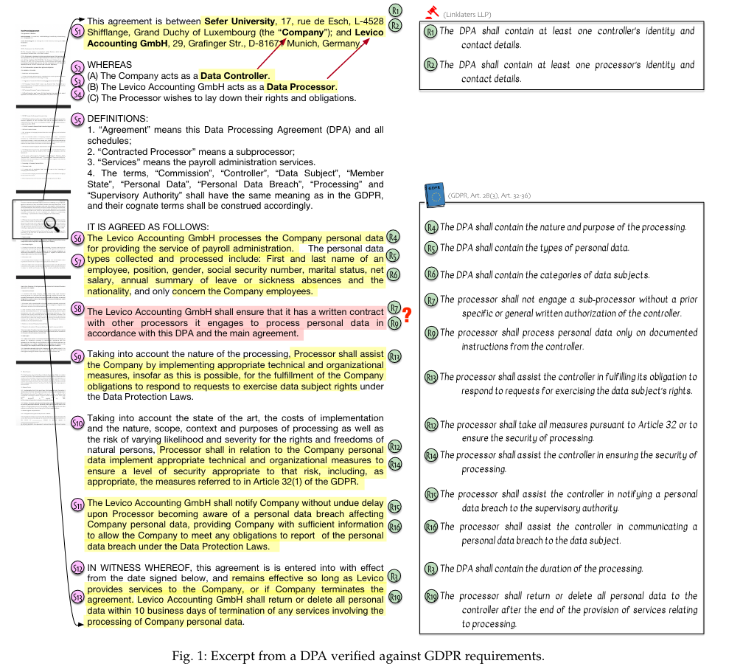
Case study: compliance checking
NLP-based Automated Compliance Checking of Data Processing Agreements against GDPR
Motivation:
Manually checking whether a given data processing agreement (DPA) complies with GDPR is challenging as it requires significant time and effort for understanding and identifying DPA-relevant compliance requirements in GDPR and then verifying these requirements in the DPA. Legal texts introduce additional complexity due to convoluted language and inherent ambiguity leading to potential misunderstandings.
[1] O. A. Cejas, M. I. Azeem, S. Abualhaija, and L. C. Briand, ‘NLP-Based Automated Compliance Checking of Data Processing Agreements Against GDPR’, IEEE Trans. Software Eng., vol. 49, no. 9, pp. 4282–4303, Sep. 2023, doi: 10.1109/TSE.2023.3288901.

Slide 16
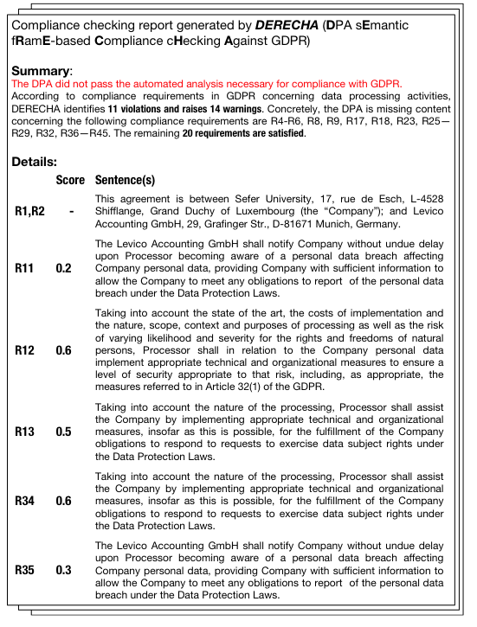
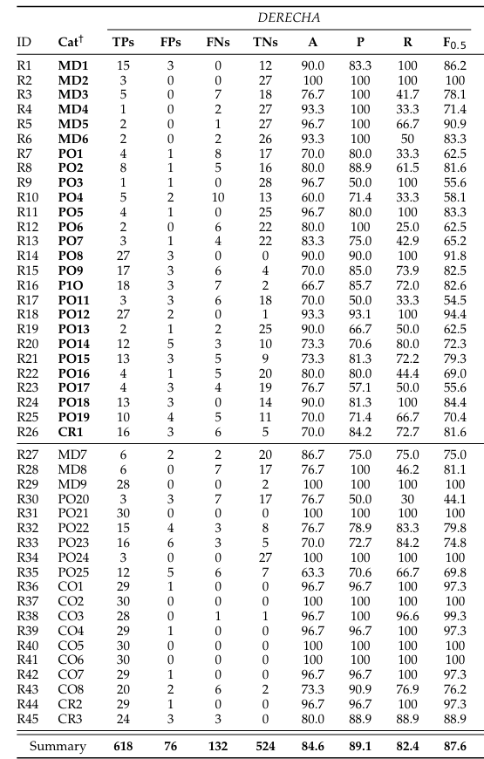
How this method performs
Over a dataset of 30 actual DPAs, the approach correctly finds 618 out of 750 genuine violations while raising 76 false violations, and further correctly identifies 524 satisfied requirements. The approach has thus an average precision of 89.1%, a recall of 82.4%, and an accuracy of 84.6%
[1] O. A. Cejas, M. I. Azeem, S. Abualhaija, and L. C. Briand, ‘NLP-Based Automated Compliance Checking of Data Processing Agreements Against GDPR’, IEEE Trans. Software Eng., vol. 49, no. 9, pp. 4282–4303, Sep. 2023, doi: 10.1109/TSE.2023.3288901.

Slide 17
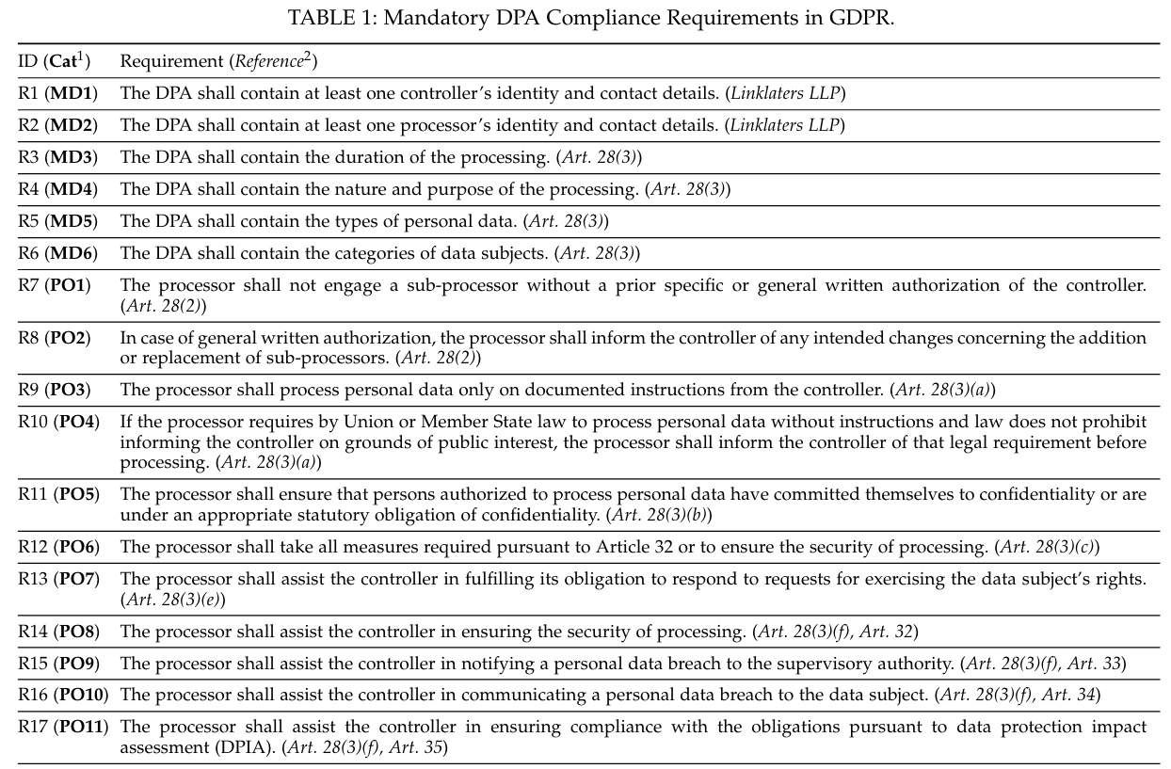
Method overview: Semantic Representation
Use semantic frame (SF) to represent compliance requirements manually
Semantic frame describes a set of elements that participate in a particular event. It is often represented as predicate-argument structure, where a predicate describes an event, and an argument describes a participant in the event labeled with a specific semantic role.
The authors defined 10 semantic roles, including action, actor, object, constraint, etc., then used the action role as the predicate and the others as the arguments to manually create SF-based representations of 45 DPA compliance requirements in GDPR
[1] O. A. Cejas, M. I. Azeem, S. Abualhaija, and L. C. Briand, ‘NLP-Based Automated Compliance Checking of Data Processing Agreements Against GDPR’, IEEE Trans. Software Eng., vol. 49, no. 9, pp. 4282–4303, Sep. 2023, doi: 10.1109/TSE.2023.3288901.

Slide 18
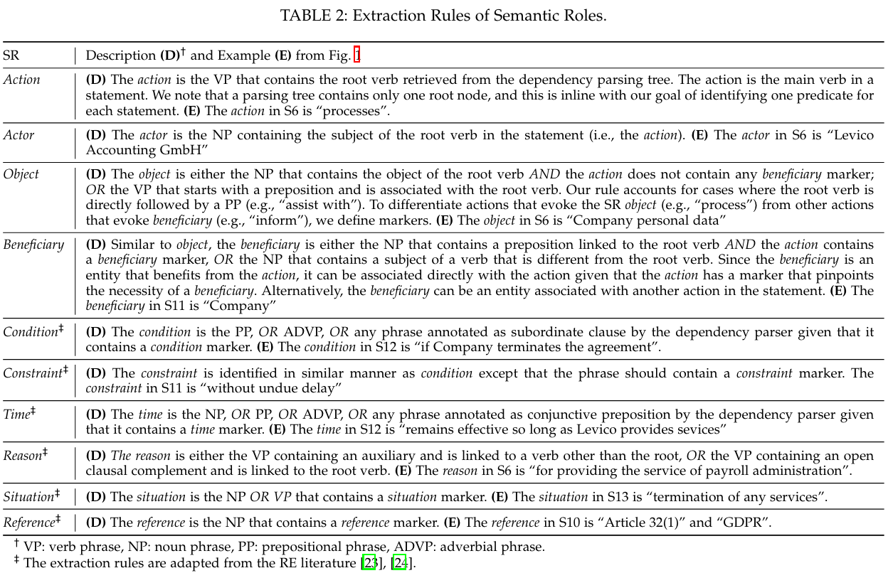
Method overview: Semantic Representation
Generate an SF-based representation for each statement in the DPA, automatically
Preprocessing: Given a DPA as input, the authors utilized a pipeline of 7 NLP modules for preprocessing, including: (1) tokenization, (2) sentence splitting and (3) pos tagging etc.
SF-based representation generation: Based on the previous annotation, the authors defined a set of rules for SF-based representation generation (as shown on the right).
Enriching text of input DPA: enrich the DPA text by extending the text spans demarcated in the previous step with semantically related words.
[1] O. A. Cejas, M. I. Azeem, S. Abualhaija, and L. C. Briand, ‘NLP-Based Automated Compliance Checking of Data Processing Agreements Against GDPR’, IEEE Trans. Software Eng., vol. 49, no. 9, pp. 4282–4303, Sep. 2023, doi: 10.1109/TSE.2023.3288901.

Slide 19
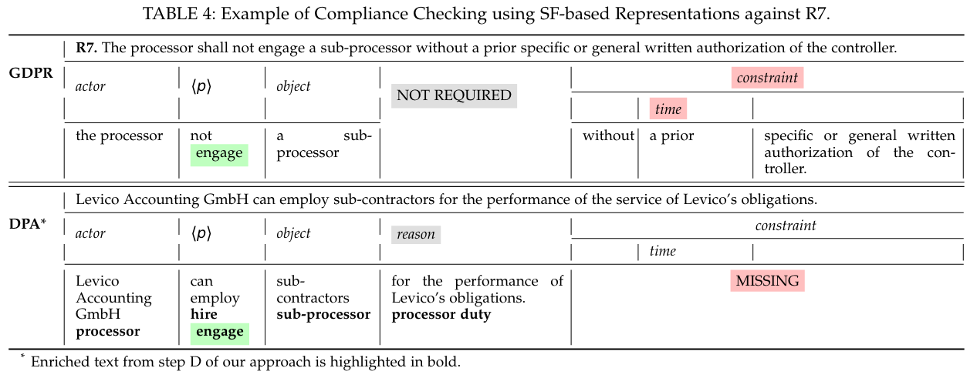
Method overview: Compliance Checking
Compliance checking by comparing SF-based representations
Matching predicates: Two predicates would be deemed to be similar if: (1) have some overlapping verbs or (2) the semantic similarity between the verb in the requirement and at least one verb in the statement is not smaller than a pre-defined threshold
Matching arguments: Any argument whose SR exists in the statement but not in GDPR is considered as not required. Conversely, an argument is missing if its SR is present in GDPR but not in the statement.
Compute matching degree: Compute a score for each compliance requirement indicating the maximum matching degree of any statement satisfying that requirement in the DPA
[1] O. A. Cejas, M. I. Azeem, S. Abualhaija, and L. C. Briand, ‘NLP-Based Automated Compliance Checking of Data Processing Agreements Against GDPR’, IEEE Trans. Software Eng., vol. 49, no. 9, pp. 4282–4303, Sep. 2023, doi: 10.1109/TSE.2023.3288901.

Slide 20

Case Study: AI for automatic regulation compliance checking

Slide 21
Case Study: AI for automatic regulation compliance checking
Aim: to develop software tools to support compliance checking.
Objective 1 (O1): to check if an organisation has put in place regulation compliant operational structure and procedure (policy)
Objective 2 (O2): to check if an employee is aware of the operational structure and procedure (procedure)
Approach 1 (Solution for O1): obligation extraction from regulation document + compliance testing on company report
Approach 2 (Solution for O2): question answering

Slide 22
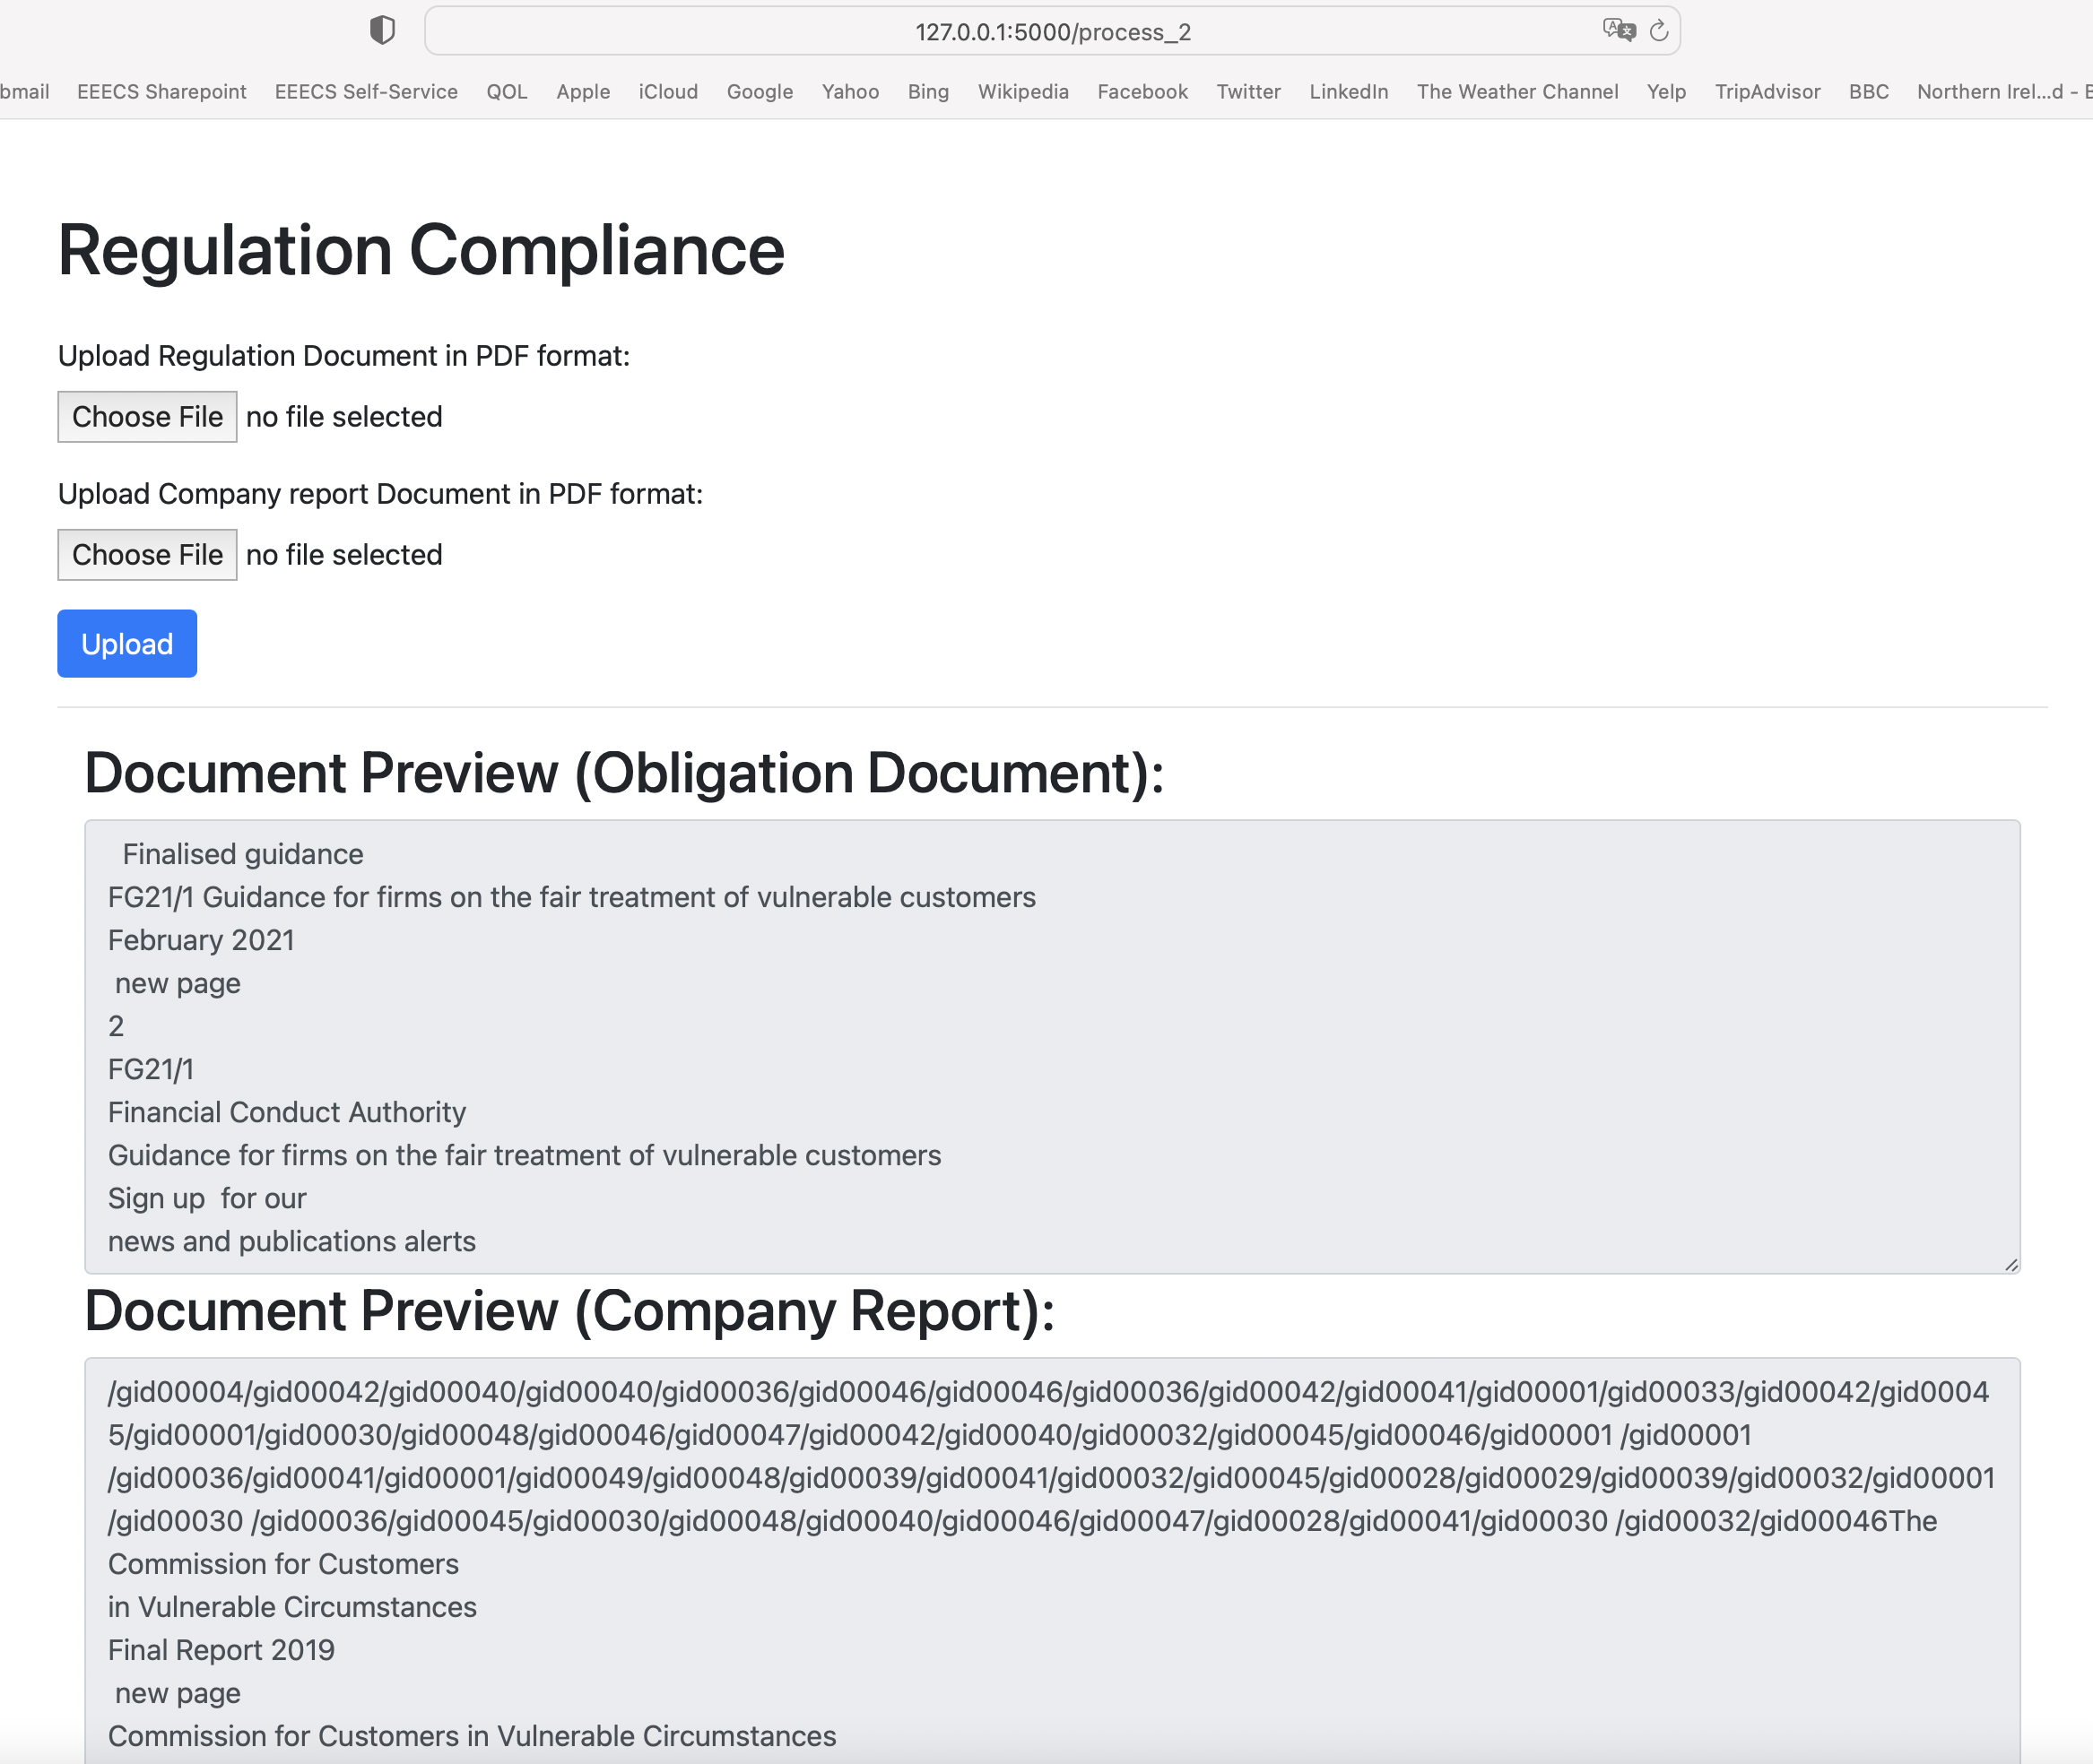
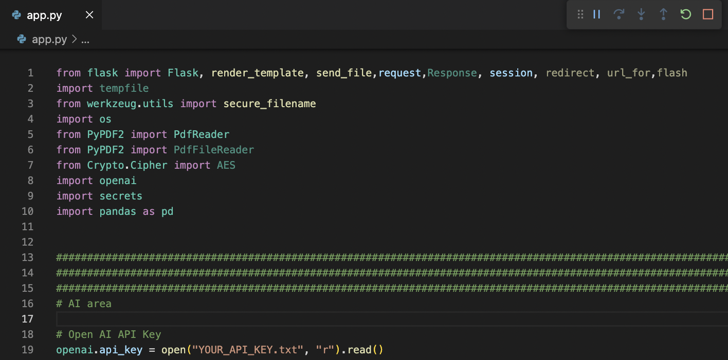
Approach 1: Obligation extraction + obligation mapping Python program + Flask Webapp Interface

Slide 23
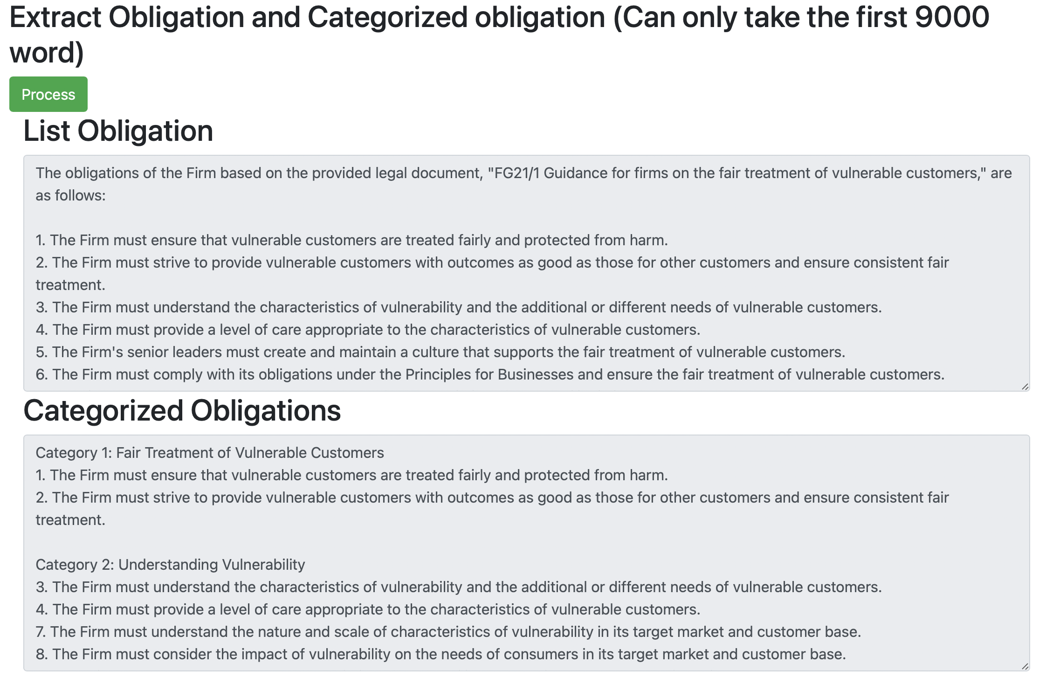
Approach 1: Obligation extraction + mapping Obligations extracted and categorised

Slide 24
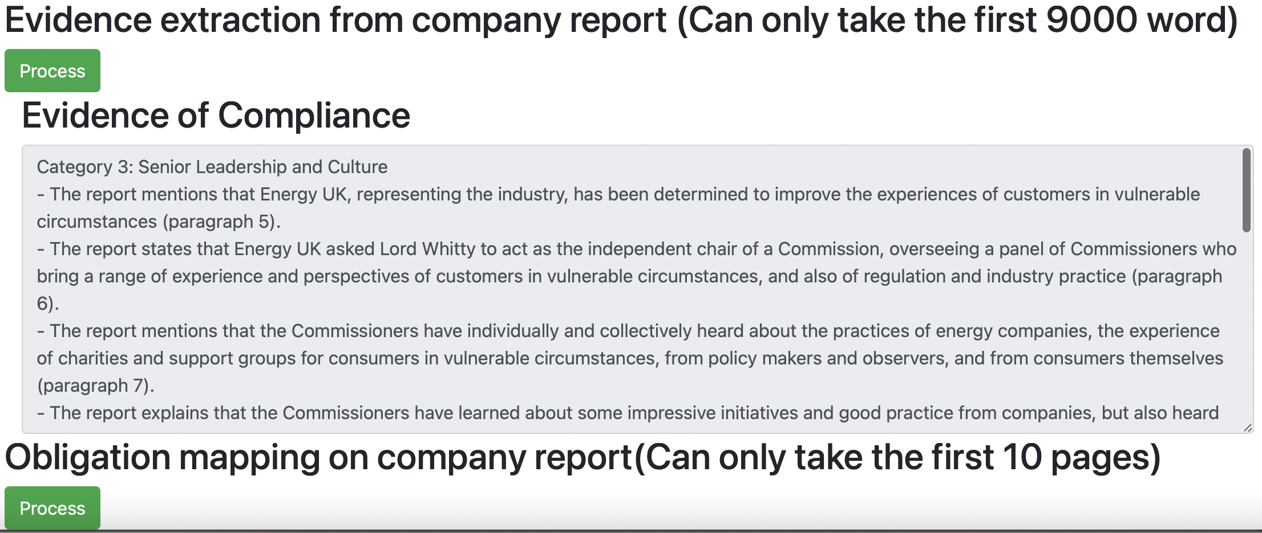
Approach 1: OE + obligation mapping + similarity of O/M Obligation mapping on company report

Slide 25
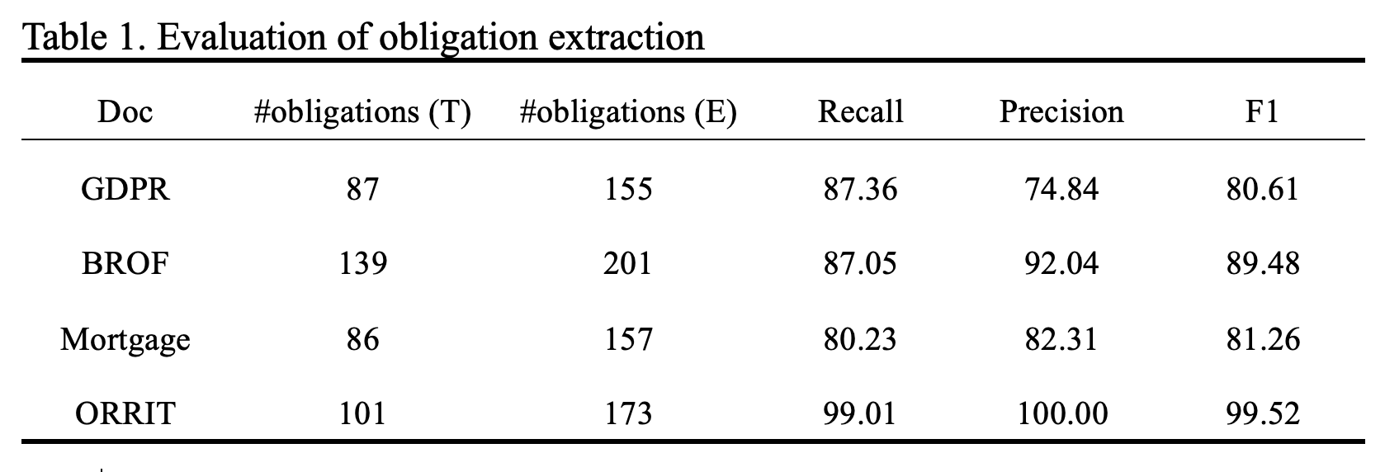
An evaluation of auto obligation extraction

Slide 26
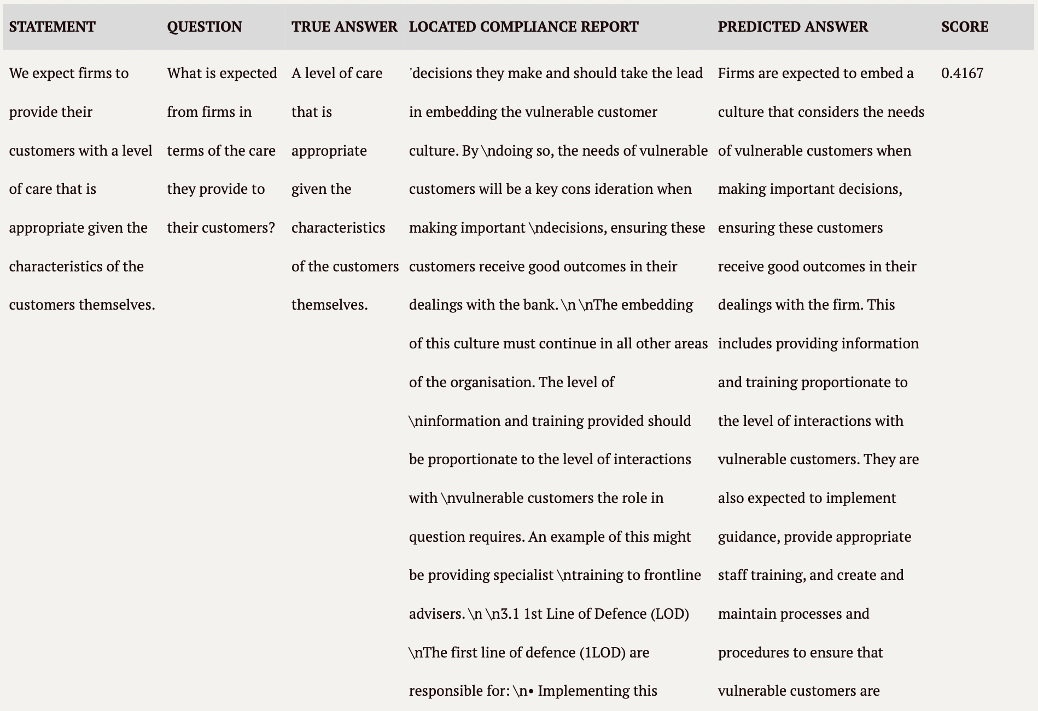
Approach 2: Obligation extraction + Question answering

Slide 27
Approach 2: Obligation extraction + Question answering (C)

Slide 28


Name: Hui Wang
Email: h.wang@qub.ac.uk

